Slide 1


BCI for Controlling Robotic Arm
309
8 Credits
26/05/2021
BCI for Controlling Robotic Arm
‹#›

Slide 2

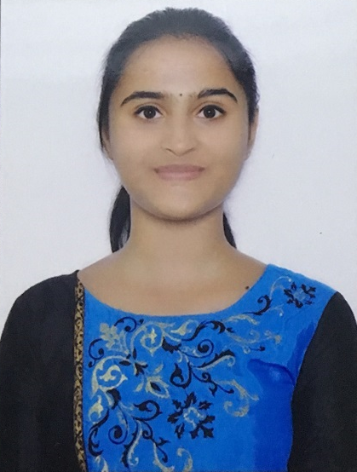
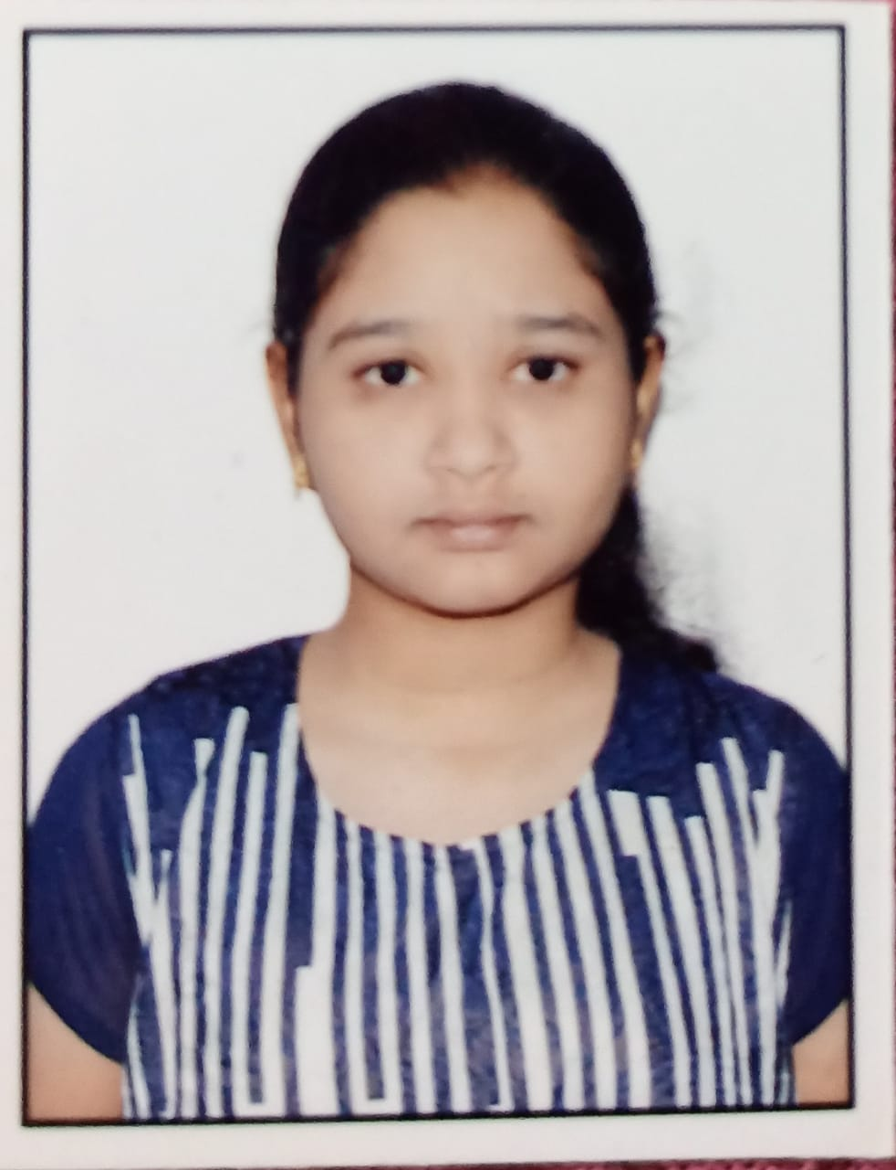
TEAM COMPOSITION
SL. NO | Name of the student | SRN | PHOTO
1 | Harshita R Vastrad | PES1201701717
2 | Shreya V Deexit | PES1201701648
3 | V Saisri | PES1201701763
Guide : Dr. B. Niranjana Krupa
Prof. Swetha G
26/05/2021
BCI for Controlling Robotic Arm
‹#›

Slide 3
TABLE OF CONTENTS
SERIAL NO | CONTENT | PAGE NO
1 | Introduction | 4
2 | Problem Statement | 5
3 | Motivation | 6
4 | Literature Survey | 7
5 | Objectives | 10
6 | Methodology | 11
7 | Result | 34
8 | Conclusion | 44
9 | Novelty | 46
10 | Individual Contribution | 47
11 | Timeline | 48
12 | References | 49
26/05/2021
BCI for Controlling Robotic Arm
‹#›
Notes:
Authors, publication details, aim or objective, methodology, results, drawbacks or void.summary of literature gaps, connect to objective,compare with other papers
Confusion matrix, category wise accuracy..

Slide 4
INTRODUCTION
Brain Computer Interfaces (BCIs) track brain activity by using electrodes to sense electric signals in the brain that are then transmitted to a computer.
The electroencephalogram (EEG) represents a type of brain signal that can be measured non-invasively by detecting electrical signals on the scalp with high temporal resolution and low cost, compared to other techniques.
26/05/2021
BCI for Controlling Robotic Arm
‹#›

Slide 5
PROBLEM STATEMENT
To use Brain computer interface (BCI) to interact between robot and human, without participation of human hand and assist the patient impaired by neurological conditions
The robotic arm will be able to pick up lightweight objects like medicines, water bottle etc. from one place as interpreted from the brain waves of the user and drop it to a predefined location
26/05/2021
‹#›
BCI for Controlling Robotic Arm
Notes:
Intro- Eeg signals, which part of brain, frequency bands,

Slide 6
MOTIVATION
The Brain Signals of patients can be used to help them communicate to others and also to perform various tasks by providing necessary infrastructure and training.
BCI system processes the electrical activity of the brain and generates the commands.Hence external devices can be controlled using these commands.
26/05/2021
‹#›
BCI for Controlling Robotic Arm
Notes:
Intro- Eeg signals, which par t of brain, frequency bands,

Slide 7
LITERATURE SURVEY
i) Ana Riza F. Quiros,Alexander C. Abad,Elmer P. Dadios,”Object locator and collector robotic arm using artificial neural networks”, 2015 International Conference on Humanoid, Nanotechnology, Information Technology,Communication and Control, Environment and Management (HNICEM)
OBJECTIVE : Build a robotic arm to accurately locate and pick an object within the arm's range.
METHODOLOGY : ANN with 1 input layer,1 hidden layer and 1 output layer. The object's location will be fed as an input to the neural network. The neural network will process this data such that it will output a set of three angles at each joint angle of the robotic arm.
RESULT : The performance is measured in terms of the mean squared error (MSE) for each epoch. MSE decreased as the number of epochs increased
VOID : A camera focusing on an object of interest will capture an image and detect the mentioned object
26/05/2021
‹#›
BCI for Controlling Robotic Arm
Notes:
https://ieeexplore.ieee.org/document/7393209

Slide 8
LITERATURE SURVEY
(ii) Maryam Mohammadi; Mohammad Reza Mosavi,”Improving the efficiency of an EEG-based brain computer interface using Filter Bank Common Spatial Pattern”,2017 IEEE 4th International Conference on Knowledge-Based Engineering and Innovation (KBEI)
OBJECTIVE : To use the filter bank CSP along with time windowing on the EEG signals to four-class classification.
DATASET : Dataset 2a of BCI Competition IV that was presented by Graz University.
METHODOLOGY : Signals are filtered using 9 sub-bands: 4-8 Hz, 8-12 Hz, …, 36-40 Hz.Then Spatial Filtering Using Common Spatial Patterns is applied.Classifier used-Naïve Bayesian Classifier
RESULT : The performance was computed in terms of kappa .The proposed method has a mean kappa of 0.6.
VOID : The performance of four-class classification on the mentioned dataset can be improved.Should focus on all sections such as preprocessing, feature extraction, feature selection and classification
26/05/2021
BCI for Controlling Robotic Arm
‹#›
Notes:
https://ieeexplore.ieee.org/document/8324921

Slide 9
LITERATURE SURVEY
Link - Literature Survey
By these papers, we can clearly see how Brain-Computer Interface(BCI) has evolved over time.
From hard-coding the distance of the object to train the model to implement image processing to detect the object and from the movement of the robotic arm in the 2D plane to 3D plane and now trying to improve the accuracy of the movement by varying the models.
26/05/2021
BCI for Controlling Robotic Arm
‹#›
Notes:
According to years, journal

Slide 10
OBJECTIVE
To use brain waves to control Robotic Arm movement
Object recognition to detect coloured objects to pick and drop
Validating the model
26/05/2021
‹#›
BCI for Controlling Robotic Arm

Slide 11
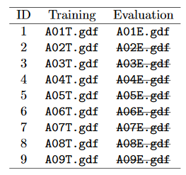
METHODOLOGY
DATASET : BCI Competition 2008 – Graz data set A
9 participants . 4 classes. Left hand,Right hand, Feet, Tongue.
Volunteers were instructed with a text on the monitor to perform either eye blinking, rolling, up-down or left-right movements
22 EEG signals, 3 EOG signals(for eye movements)
Signals were sampled at 250Hz, and bandpass 0.5Hz and 100Hz,The sensitivity of the amplifier was set to 100μV. An additional 50 Hz notch filter was enabled to suppress line noise.
Files are in .gdf format
Files in the dataset:
26/05/2021
Robotic Arm BCI
‹#›
Notes:
Methodology
-explain first what section is explained
-data set
--block diagram
Objects shown(stimulus)

Slide 12
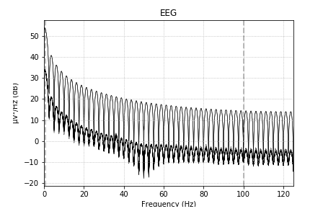
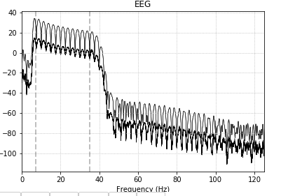
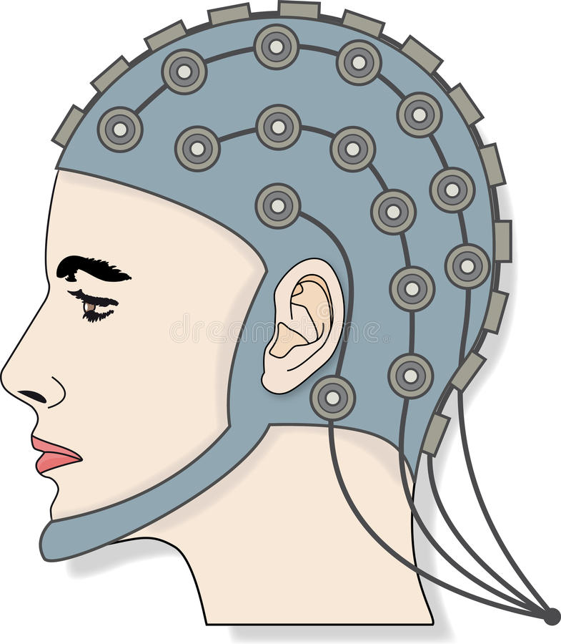
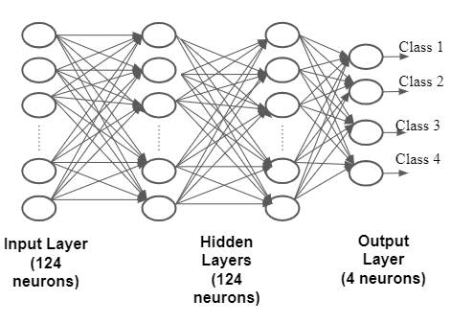
BLOCK DIAGRAM
SIGNAL PRE-PROCESSING
Bandpass filter
Select 22 channels
Rename channels
Wavelet Packet Decomposition
25 channels
288, 22, 751
FIR filter parameters:
Hamming window
Lower passband edge: 7.00
Upper passband edge: 35.00 Hz
Order :4
bads: 3 items (EOG-left, EOG-central, EOG-right)
288, 22, 751
Train test split
80:20
Test: 58,32
Train: 230,32
Raspberry Pi camera
Robotic Arm
Raspberry Pi
‹#›
Figure 1: EEG Signals and Robot Interface Schematic
ANN Model
Notes:
Pre-processing block ,include figure number

Slide 13
WORKFLOW
Extracting the data
Find the events
Bandpass filter
Removing bad channels
Plotting desired epochs
Renaming the labels
10 fold cross validation
Model build
Wavelet packet decomposition
Metrics
26/05/2021
BCI for Controlling Robotic Arm
‹#›
Notes:
Software part

Slide 14
WORKFLOW
Extracting the data
Find the events
Bandpass filter
Removing bad channels
Plotting desired epochs
Renaming the labels
10 fold cross validation
Model build
Wavelet packet decomposition
Metrics
26/05/2021
BCI for Controlling Robotic Arm
‹#›

Slide 15
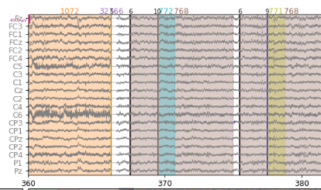
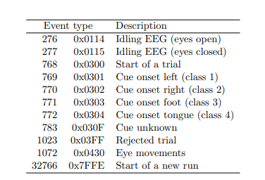
EVENTS
Figure 2: Plot of different channels vs time along with partitioning the events
26/05/2021
BCI for Controlling Robotic Arm
‹#›

Slide 16
WORKFLOW
Extracting the data
Find the events
Bandpass filter
Removing bad channels
Plotting desired epochs
Renaming the labels
10 fold cross validation
Model build
Wavelet packet decomposition
Metrics
26/05/2021
BCI for Controlling Robotic Arm
‹#›

Slide 17
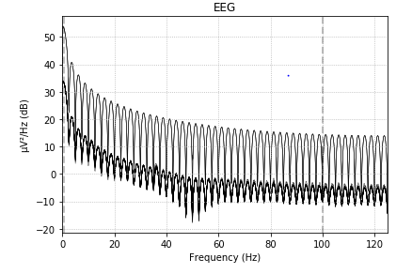
OUTPUT AFTER BAND PASS FILTERING
Figure 3 : Frequency spectrum before bandpass filtering
Figure 4 : Frequency spectrum after bandpass filtering
26/05/2021
BCI for Controlling Robotic Arm
‹#›

Slide 18
WORKFLOW
Extracting the data
Find the events
Bandpass filter
Removing bad channels
Plotting desired epochs
Renaming the labels
10 fold cross validation
Model build
Wavelet packet decomposition
Metrics
26/05/2021
BCI for Controlling Robotic Arm
‹#›

Slide 19
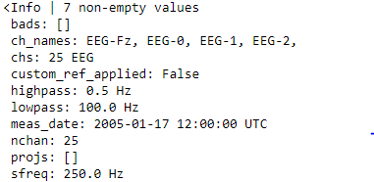
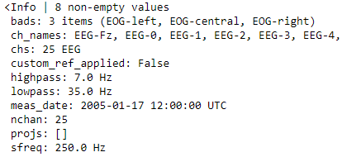
OUTPUT AFTER REMOVING BAD CHANNELS
26/05/2021
BCI for Controlling Robotic Arm
‹#›
Notes:
In a table , change heading

Slide 20
WORKFLOW
Extracting the data
Find the events
Bandpass filter
Removing bad channels
Plotting desired epochs
Renaming the labels
10 fold cross validation
Model build
Wavelet packet decomposition
Metrics
26/05/2021
BCI for Controlling Robotic Arm
‹#›

Slide 21
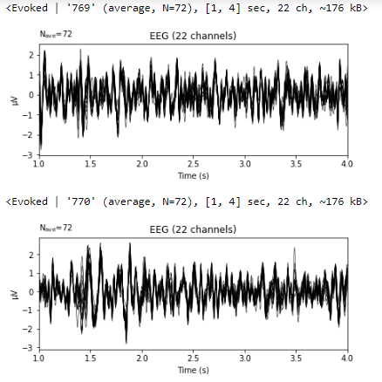
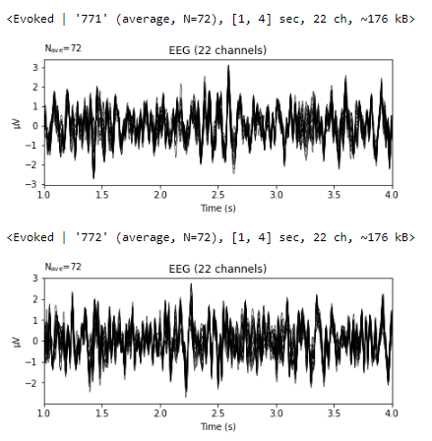
EPOCHS
Figure 5: Left = 769, Right = 770, Forward = 771, Backward=772
26/05/2021
BCI for Controlling Robotic Arm
‹#›
Notes:
Can add screenshots of plotted waveforms
Ica pictures
Accuracy screenshots

Slide 22
WORKFLOW
Extracting the data
Find the events
Bandpass filter
Removing bad channels
Plotting desired epochs
Getting labels and changing labels from 7,8,9,10 -> 1,2,3,4
Renaming the labels
10 fold cross validation
Model build
Wavelet packet decomposition
Metrics
26/05/2021
BCI for Controlling Robotic Arm
‹#›

Slide 23
WORKFLOW
Extracting the data
Find the events
Bandpass filter
Removing bad channels
Plotting desired epochs
Renaming the labels
Metrics
10 fold cross validation
Model build
Wavelet packet decomposition
Signal is decomposed to level 5 with 'db4' wavelet.db4 is chosen due to their near optimal time frequency localisation properties.
26/05/2021
BCI for Controlling Robotic Arm
‹#›

Slide 24
WORKFLOW
Extracting the data
Find the events
Bandpass filter
Removing bad channels
Plotting desired epochs
Renaming the labels
Metrics
10 fold cross validation
Model build
Wavelet packet decomposition
8 frequency band coefficients are chosen from the range 4-32Hz
26/05/2021
BCI for Controlling Robotic Arm
‹#›

Slide 25
WORKFLOW
Extracting the data
Find the events
Bandpass filter
Removing bad channels
Plotting desired epochs
Renaming the labels
10 fold cross validation
Model build
Wavelet packet decomposition
Metrics
26/05/2021
BCI for Controlling Robotic Arm
‹#›

Slide 26
ANN MODEL
Class 1- Left
Class 2 -Right
Input
Class 3 - Front
Class 4 - Back
Input Layer
(124 neurons)
Hidden Layers
(124 neurons)
Output Layer
(4 neurons)
‹#›
26/05/2021
BCI for Controlling Robotic Arm
Notes:
Map class 1
Dimension of input, title

Slide 27
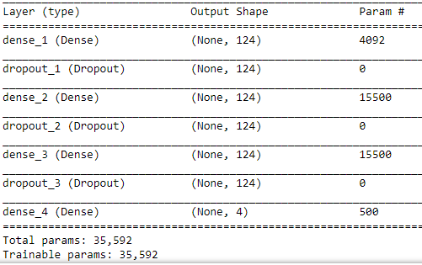
MODEL SUMMARY
Dropout : 0.5
L2 regularizer
Optimizer : rmsprop
2 Hidden Layers
loss = Categorical crossentropy
Figure 6: Summary of the model
26/05/2021
BCI for Controlling Robotic Arm
‹#›

Slide 28
WORKFLOW
Extracting the data
Find the events
Bandpass filter
Removing bad channels
Plotting desired epochs
Renaming the labels
10 fold cross validation
Model build
Wavelet packet decomposition
Metrics
26/05/2021
BCI for Controlling Robotic Arm
‹#›

Slide 29
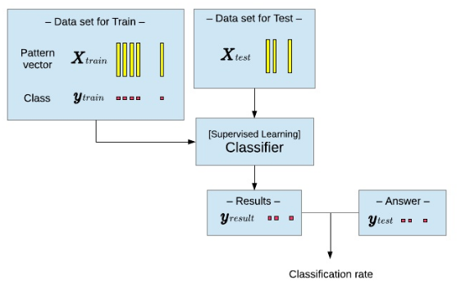
Train Test Split
20%
80%
ANN Model
Figure 7: Train test split
26/05/2021
BCI for Controlling Robotic Arm
‹#›

Slide 30
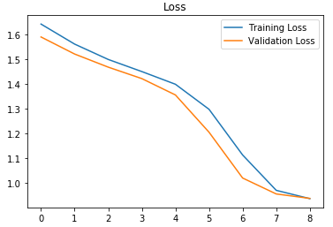
FINE TUNING
Early stopping
Too many epochs can lead to overfitting of the training dataset, whereas too few may result in an underfit model.
Early stopping is a method that allows to specify an arbitrary large number of training epochs and stop training once the model performance stops improving on a hold out validation dataset.
Figure 8: Illustration of early stopping
26/05/2021
BCI for Controlling Robotic Arm
‹#›

Slide 31
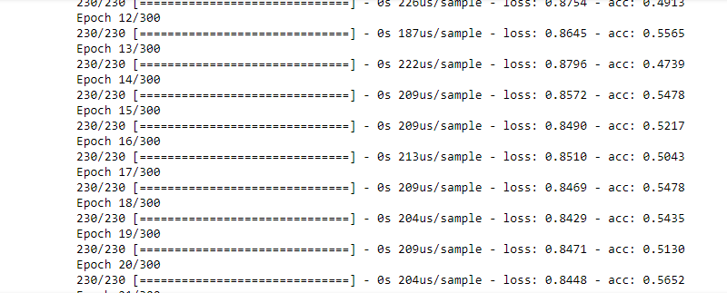
Training
From 288 data samples, 230 are used for training and rest 58 are used for testing. The model was initially trained on 230 with 300 epochs, after which the early stopping was implemented such that training loss never goes below validation loss.
Figure 9: Training phase
26/05/2021
BCI for Controlling Robotic Arm
‹#›

Slide 32
WORKFLOW
Extracting the data
Find the events
Bandpass filter
Removing bad channels
Plotting desired epochs
Renaming the labels
10 fold cross validation
Model build
Wavelet packet decomposition
Metrics
26/05/2021
BCI for Controlling Robotic Arm
‹#›

Slide 33
VALIDATION
Fine tuning the model by varying different parameters
Parameters | Accuracy
Changing the optimizer (adam) | 68.27%
Changing drop out value(0.2) | 67.06%
Number of layers | 68.79% (Two hidden layers) 67.23% (Single hidden layer)
Early stopping | 70.6%
L2 Regularisation | 69.65%
26/05/2021
BCI for Controlling Robotic Arm
‹#›

Slide 34
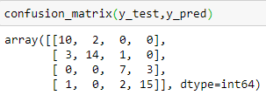
RESULT
Fold | Accuracy | Kappa | Precision | Recall
F1 | 0.689655 | 0.585714 | 0.692926 | 0.689655
F2 | 0.706897 | 0.609040 | 0.719330 | 0.706897
F3 | 0.741279 | 0.655446 | 0.777157 | 0.741379
F4 | 0.689655 | 0.588003 | 0.721065 | 0.689655
F5 | 0.793103 | 0.724466 | 0.803831 | 0.793103
F6 | 0.586207 | 0.449802 | 0.696717 | 0.586207
F7 | 0.655172 | 0.533949 | 0.676194 | 0.655172
F8 | 0.741379 | 0.648910 | 0.741323 | 0.741379
F9 | 0.689655 | 0.577670 | 0.697079 | 0.689655
F10 | 0.810345 | 0.740439 | 0.819376 | 0.810345
Avg | 0.710345 | 0.611344 | 0.734410 | 0.710345
After trying many variations in the model, this is the best accuracy we have got
26/05/2021
BCI for Controlling Robotic Arm
‹#›
Notes:
In table, kappa

Slide 35
CONSTRAINTS
Colored objects are considered to be Lightweight objects
Input given to robotic arm and object color that has to be picked
Class 1 - Left - Orange
Class 2 - Right - Red
Class 3 - Front - Blue
Class 4 - Back - Green
Based on the input Robotic arm rotates and moves in that direction,
detecting the colored object.
‹#›
26/05/2021
BCI for Controlling Robotic Arm

Slide 36

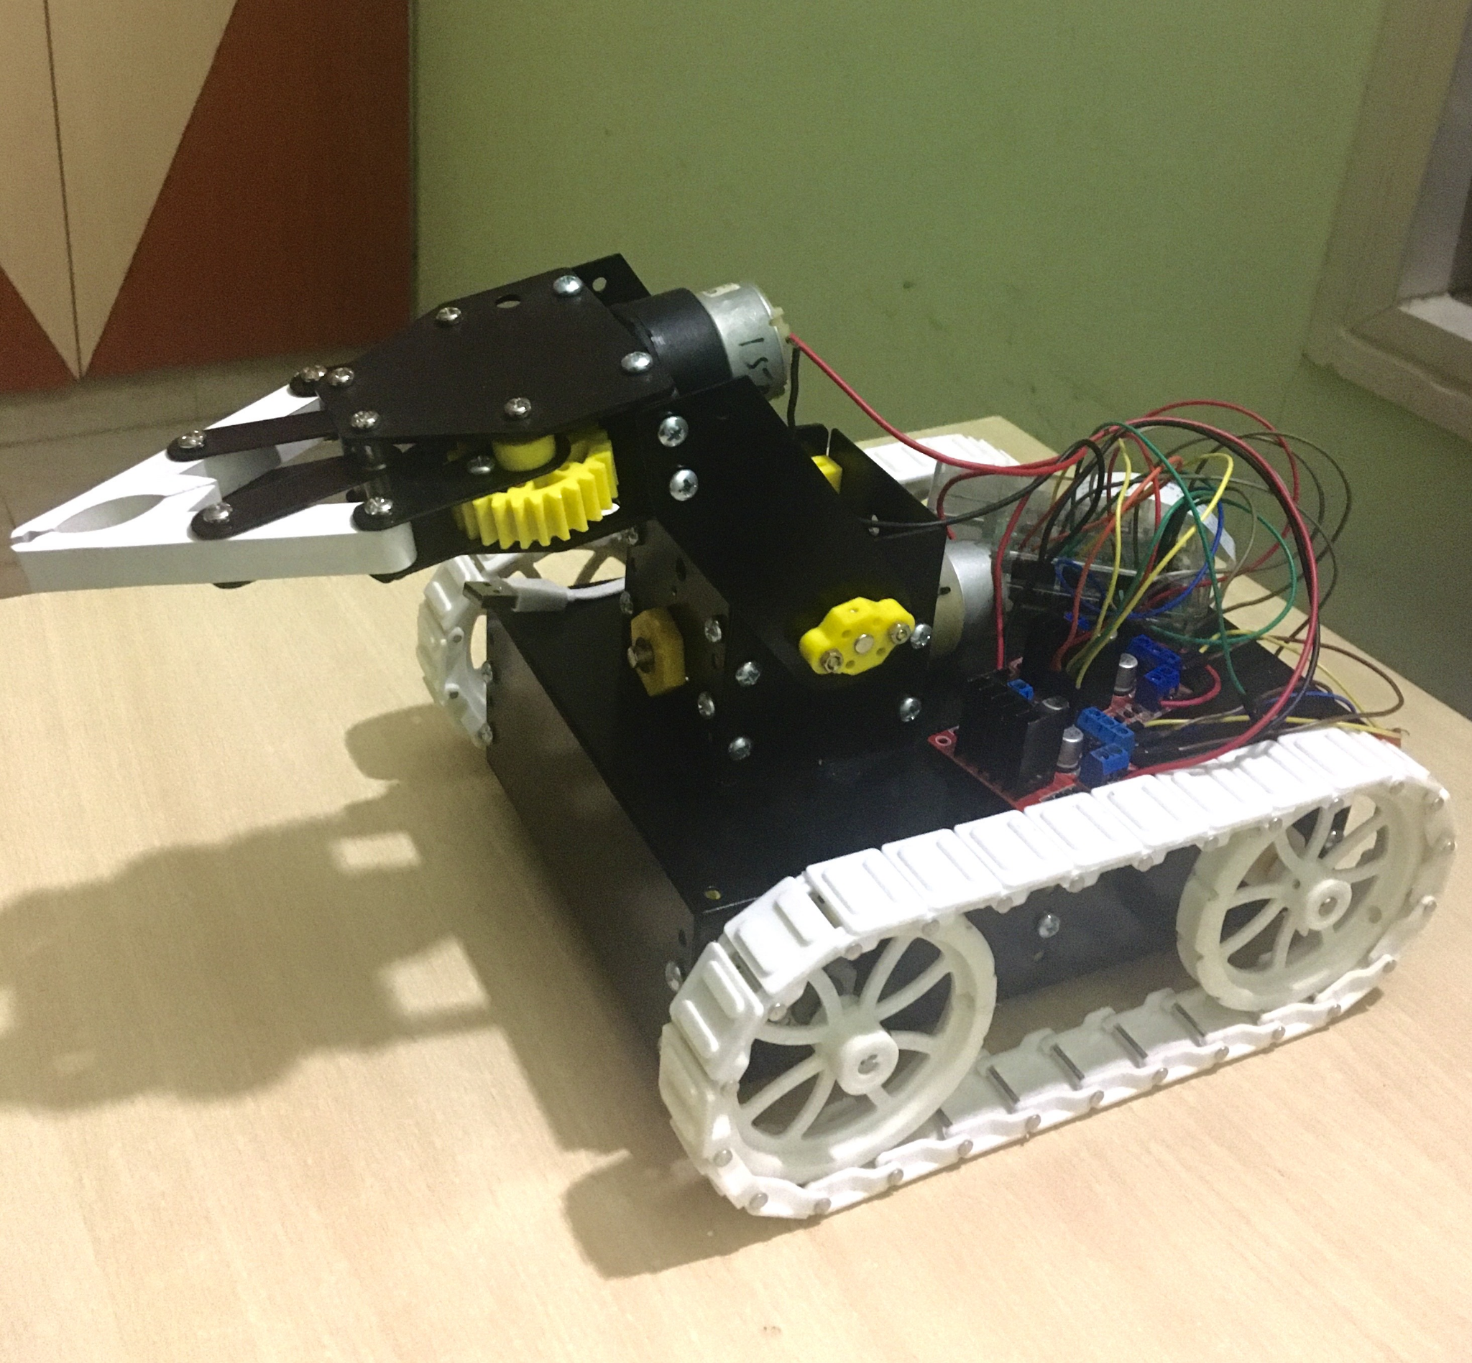




MOTOR MOVEMENTS
Figure 10: The Robotic Arm used in the project
Path followed by robotic arm
‹#›
26/05/2021
BCI for Controlling Robotic Arm

Slide 37
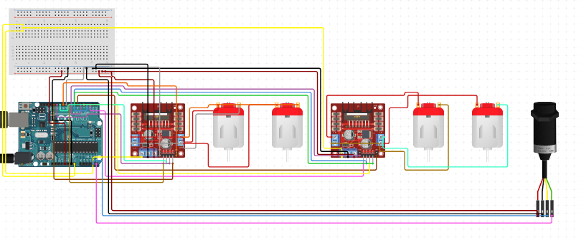
CIRCUIT DIAGRAM
Component Specifications:
4 DC motors
Two motors for controlling wheels and the other two to control robotic arm
2 H-bridge
To control DC motors
Pi Camera
For object colour detection
Raspberry Pi 3 Model A+ processor
Camera
Raspberry Pi
DC Motors
DC Motors
Figure 11: Circuit Diagram
‹#›
26/05/2021
BCI for Controlling Robotic Arm

Slide 38
TENSORFLOW SETUP
The model weights were saved and sent to the raspbian OS using SCP(Secure copy).Scp is a command for sending files over SSH. This is used to copy files between computers, say from your Raspberry Pi to your desktop or laptop, or vice-versa.
Transfer files :
scp saved_model pi@192.168.1.3:
Then using the tensorflow load module (load_model) we loaded the model on Raspberry Pi and provided the input to the model which has the dimension of 230x32. The model accordingly classifies the input and provides us the class number.
‹#›
26/05/2021
BCI for Controlling Robotic Arm
Notes:
Highlight Second part

Slide 39
INSTALLING MODULES
Cmake
Libjpeg-dev,Libpng-dev,Libtiff-dev
Libavcodec-dev,Libavformat-dev,Libswscale-dev,Libv4l-dev
Libxvidcore-dev,Libx264-dev
Libgtk-3-dev
Libatlas-base-dev gfortran
python3-dev
OpenCV
‹#›
26/05/2021
BCI for Controlling Robotic Arm

Slide 40
WORKFLOW
Get image frames from video
Convert BGR color space to HSV color space
Define the range and create mask
Capture video through pi camera
Create contour to track color
Bitwise and between image frame and mask
Color detection
Dilation
‹#›
26/05/2021
BCI for Controlling Robotic Arm

Slide 41
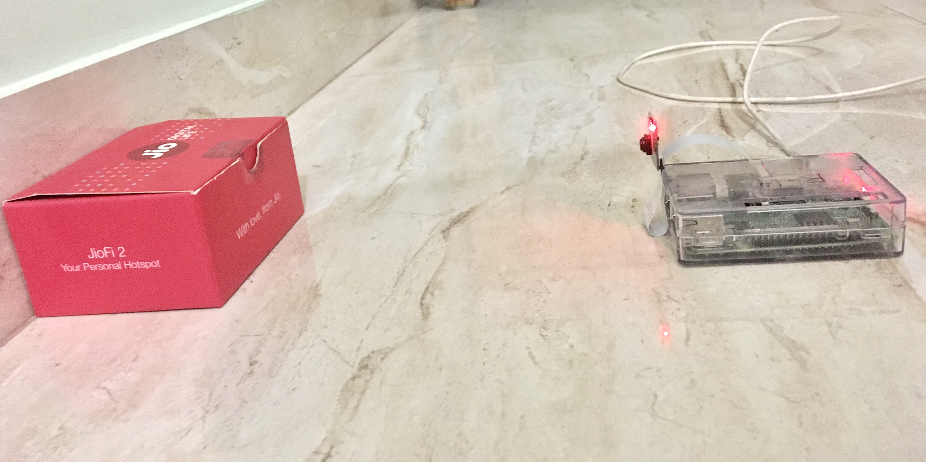
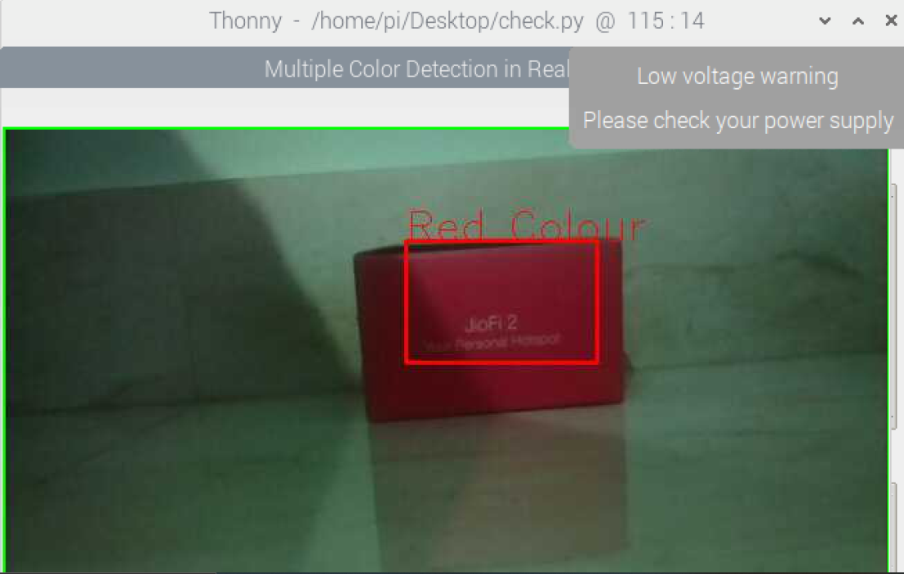
OBJECT COLOR DETECTION
Figure 12: Setup for colour detection
Figure 13: Image showing the output of detected red coloured object
‹#›
26/05/2021
BCI for Controlling Robotic Arm

Slide 42
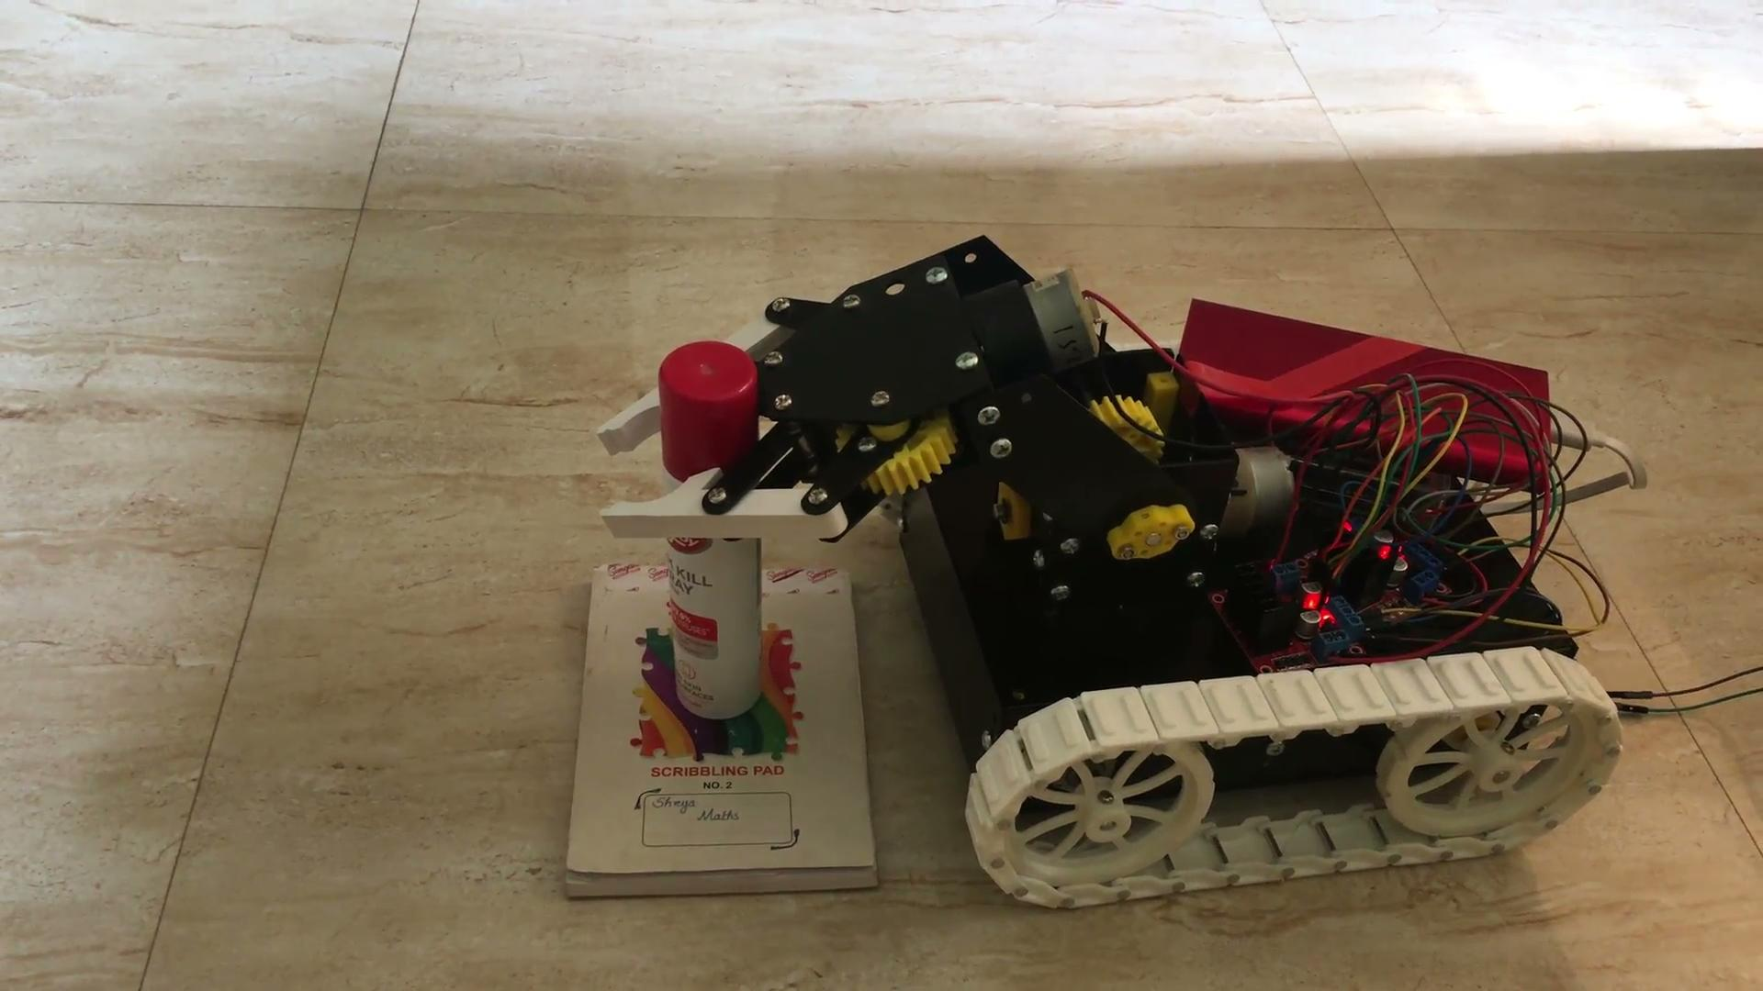
DEMO
Demonstration of the Robotic Arm moving in forward direction
‹#›
26/05/2021
BCI for Controlling Robotic Arm
Notes:
Change headings

Slide 43
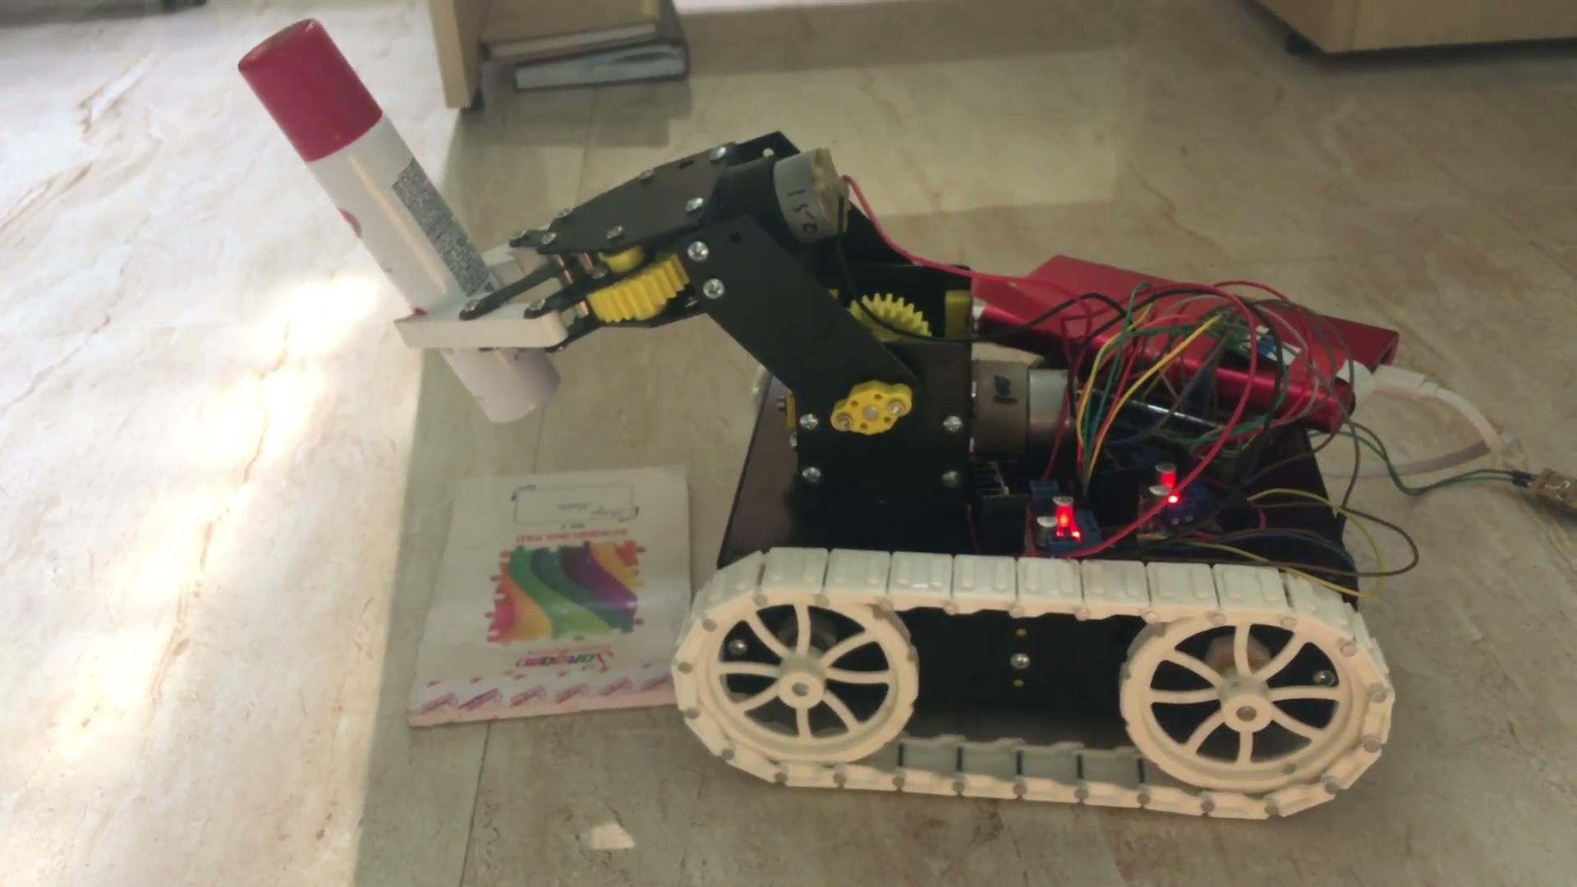
DEMO
Demonstration of the Robotic Arm moving in right direction
6/05/2021
Robotic Arm BCI
‹#›

Slide 44
CONCLUSION
Robotic Arm can be used for people with disabilities, as well as those who do not have a physical body.
By comparing the accuracies of all the variants, we can conclude that using Rmsprop optimizer, dropout of 0.5 and with 2 hidden layers generated the best average accuracy of 71.03 percent. Including early stopping helped in increasing the accuracy
The robotic arm was capable of moving towards a particular direction and pick and place objects.
‹#›
26/05/2021
BCI for Controlling Robotic Arm
Notes:
Drawbacks, and what can be improved ,https://www.makesigns.com/SciPosters_Templates.aspx

Slide 45
FUTURE SCOPE
The region where the project is to conducted should have an excellent lighting framework, since there is an object colour recognition included
The items which should be picked by the robotic arm should be light weight.
The colors are predefined to detect objects easily
The test environment should not have any obstacle.
‹#›
26/05/2021
BCI for Controlling Robotic Arm
Notes:
Drawbacks, and what can be improved

Slide 46
NOVELTY
ANN Model
The model developed to classify the EEG signals consist of four layers, and various methods like dropout layers and early stopping was implemented to overcome the problem of overfitting.
Mobile Robotic Arm
The robotic arm is capable of moving in four different directions to pick and place objects and is not fixed in a specific spot.
26/05/2021
BCI for Controlling Robotic Arm
‹#›

Slide 47
INDIVIDUAL CONTRIBUTION
Name | Contribution
V SaisrI | Literature Survey, Extracting Data from dataset,Renaming the labels, Building model, Train test split, Object Detection
Harshita R Vastrad | Literature Survey, Finding Events, Plotting epochs,Feature extraction, Building model, Early stopping, Getting components, Motor movements
Shreya Vittal Deexit | Literature Survey, Applying Bandpass filter, Channel Selection, Building model, Integrating the model with Pi, Tensorflow Set up
26/05/2021
BCI for Controlling Robotic Arm
‹#›

Slide 48
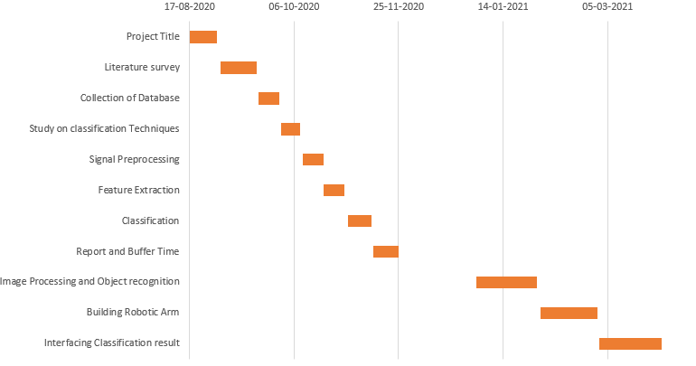
TIMELINE
26/05/2021
BCI for Controlling Robotic Arm
‹#›

Slide 49
REFERENCES
Pronadeep Bora; Vishwajit Nandi,”Low cost shadow function based articulated robotic arm”, 2015 International Conference on Energy, Power and Environment: Towards Sustainable Growth (ICEPE)
Ana Riza F. Quiros,Alexander C. Abad,Elmer P. Dadios,”Object locator and collector robotic arm using artificial neural networks”, 2015 International Conference on Humanoid, Nanotechnology, Information Technology,Communication and Control, Environment and Management (HNICEM)
Son Ngoc Truong Faculty of Electrical and Electronics Engineering HCMC University of Technology and Education,”A Low-cost Artificial Neural Network Model for Raspberry Pi”Engineering, Technology & Applied Science Research
Running a Convolutional Neural Network on Raspberry PI https://medium.com/swlh/running-a-convolutional-neural-network-on-raspberry-pi-4fc5bd80aa4d
Ji-Hoon Jeong , Kyung-Hwan Shim , Dong-Joo Kim , and Seong-Whan Lee, “Brain-Controlled Robotic Arm System Based on Multi-Directional CNN-BiLSTM Network Using EEG Signals”,IEEE Transactions on Neural Systems and Rehabilitation Engineering (Volume: 28 , Issue: 5, May 2020 )
C P Shantala,C R Rashmi,“Mind controlled wireless robotic arm”,2017 IEEE International Conference on Computational intelligence and computing research.
Rich Caruana, Steve Lawrence, and Lee Giles,“ Overfitting in Neural Nets: Backpropagation, Conjugate Gradient, and Early Stopping.”
‹#›
26/05/2021
BCI for Controlling Robotic Arm
Notes:
Novelty, individual contribution,

Slide 50
THANK YOU...
26/05/2021
BCI for Controlling Robotic Arm
‹#›

